Slide 1
A Presentation By:
Ndikintum Carl Nfon
Nyenty Eyong Arrehquette
Obasiarrey M’oneke Mary
Orocktakang Agborbeja
Salle-Njume Meryl

Slide 2
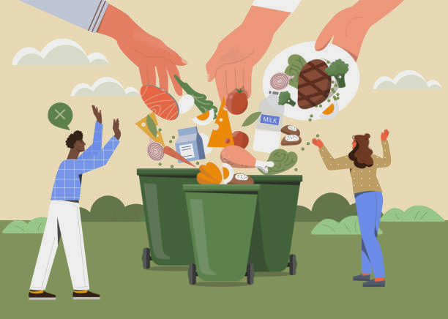
DESIGN AND MANAGEMENT OF A FOOD WASTE MANAGEMENT APP
(FOOD DONATION PLATFORM)

Slide 3
INTRODUCTION
A food waste management app is a platform that allows users to donate food items they no longer need to others who may need them. The goal of this platform is to reduce food waste and provide access to food for those in need. This document outlines the software requirements for the platform.

Slide 4
PURPOSE SCOPE
1
The food waste management and donation platform aims at ensuring there’s proper management of food wastage .So this document consists of a simple explanation about the system and its features.
Developing a user-friendly platform with features such as search and filtering options to help users find available food donations as well as a way to facilitate the pickup and delivery of donations.

Slide 5
PROPOSED SYSTEM
A platform that allows people and even businesses to upload excess food for others to buy or even get it for free. This will reduce the rate at which food is wasted and also give an opportunity to those buying to get it at a cheaper price or even for free.

Slide 6
Problem statement
There is a significant amount of food waste in our society, which has negative environmental and social impacts. At the same time, there are people who struggle with food insecurity and could benefit from access to food at a cheaper price or for free. Therefore, there is a need for a food waste management platform that allows individuals and businesses to donate excess food, which can then be made available to those in need.

Slide 7
FUNCTIONAL REQUIREMENTS.
User registration
Food donation
Food receivers
Food search
Food pickup
Tracking
Feedback

Slide 8
Non-functional requirements.
Performance
Security
Usability
Technical requirements which is further divided into platform, programming languages & frameworks used and database

Slide 9
Requirements Analysis
Requirements analysis refers to the process of defining the expectations of stakeholders on a project, in this case, the stakeholders of the food waste management platform.

Slide 10
Stakeholders
User
Food management app
Customer

Slide 11
Thank you for your keen attention!

